Slide 1
GROUP MEMBER
Mior Farhansyukri
Khairul Abidin
-
-
-
Nur Syuhaidah
Fatin Hazirah
-
-
-

Slide 2
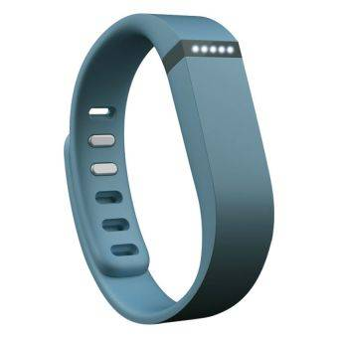
Fitbit Flex Wireless Activity + Sleep Tracking Wristband Slate
HARD AT WORK.
EASY ON YOU!!

Slide 3
PRODUCT FUNCTIONS
Goals and Tracking
- Uses LED lights to show how stacking up against daily goal.
Wireless Sync
- Select Bluetooth 4.0 devices, without plugging in or pushing buttons.
Dashboard
- Fitbit App for iPhone and Android to track steps, distance, calories, active minutes, and sleep, and receive goal progress notifications and milestone updates.
Compatibility
- Flex syncs with popular fitness apps for an integrated fitness regiment.
Badges
-Flex keeps you motivated and helps you reach and celebrate milestones by awarding badges as you reach daily and lifetime achievements and goals.

Slide 4
WHO WILL BUY THIS PRODUCT
Adult
Teenager
This product is compatible receiver for all. No matter the adults or teenagers.

